Slide 1
Purity And Impurity
طہارت اور نجاست

Slide 2
Taha rat (Purity)Najasat (Impurity)
Remove from your body and cloths two Impurities before prayers.
Najasat Haqeeqi: are those impurities which can be seen and felt and in the material form.
Najasat Hukmi: are those impurities which can’t be seen.
a. Need for Wudu (ablution)
b. Need for Ghuthul (bath)

Slide 3
Types Of Cleaning
There are three types of Cleaning:
Istinja
Wudhu
Ghusl

Slide 4
Istinja
استنجاء
To Go wash room

Slide 5
Things To Do…….,
To say Bismillah & make du'a' before entering the toilet.
To Wash the parts thoroughly.
But the doubtful person should wash three or seven times.
To make du'a' after leaving the toilet.
Come out from the toilet with right leg

Slide 6
Things Not To Do……,
To talk
To cough unnecessarily
To read some verse of the Qur’an, Hadith or respected things.
To take some things on which the respected things are written.
To relieve oneself in a standing position without genuine case.
To remove all cloths.
To make Istinja with right hand.
To enter the toilet with the right leg.
To face towards Qibla.
To make Istinja with bones, impurities, coal, glass, Edible, etc.
To enter the toilet bare headed.
To take the name of Allah.
To do on the bank of river, pond, etc.
To do under the trees

Slide 7
Ablution
وضوء

Slide 8
Virtue Of Wudhu
According to Hadith….,
Prophet (sw) said:
On the day of judgment, when my Ummah will be called, their Faces, Hands and Legs will be brighten and shining due to the (water of) wudhu.

Slide 9
Compulsory (Farz) Acts of Wudu
يأيها الذين آمنوا إذا قمتم إلى الصلوة فاغسلوا وجوهكم وأيديكم إلى المرافق وامسحوا برؤسكم وأرجلكم إلى الكعبين (سورة المائدة)
O you who believe, when you rise for Salah (prayer) wash your faces and your hands up to the elbows, and make Masah (wiping by hands) of your heads and (wash) your feet up to the ankles.
To wash the entire face once.
To wash both hands up to and including elbows once.
To make masah of one-quarter of the head once.
To wash both feet once up to and including the ankles.

Slide 10
Sunnah acts for Wudu
Make the Intention.
Recite بسم الله والحمد لله
Wash both hands up to wrists.
Clean the mouth with Miswak.
Gargle the mouth thrice.
Put the water into the nostrils by blowing thrice.
To make Masah of the entire head & ears.
To wash each part three times.
To make Khilal of the fingers and toes.
Wash each limb thrice.
Dua'a' after wudhu and recite the Shahadah.
Wudhu done systematically.
Washing of each part one after the other without pause, so no part dries up before the wudhu is completed.

Slide 11
Things that break Wudu
Passing urine, or stool, or air.
Any flowing impurity Blood, pus, from such a body part which is washed in Wudu or Ghusl.
Vomit of food, clots of blood, or yellow water which is mouthful.
Sleeping while lying down or by resting the body against something.
Laughing in such a salat that has Roku and sajdah.
Consuming any form of intoxicants.
Madness
Unconsciousness.

Slide 12
Bath
غسل

Slide 13
Compulsory (Farz) Acts of Bath
Allah stated:
وإن كنتم جنبا فاطهروا
If you are in a state of major impurity, clean yourselves well
(by taking bath)
There are three Compulsory (Farz) Acts :
To Gargle one’s mouth (in such a way that water reaches the entire mouth)
To place water in the nose. (Up to the soft portion)
To make water reach the entire body.

Slide 14
SUNNAT Acts of GHUSL
There are five sunnat in ghusl.
Washing hands up to the wrists.
Washing the private parts and thepartsover which impurity is found.
Niyyat of washing off Hukmi Najaasat
Making Wudhu before washing the body.
Then passing water over the whole body thrice.

Slide 15
Dry Ablution
تیمم

Slide 16
Allah stated:
وإن كنتم مرضى أو على سفر أو جآء أحدكم من الغائط أو لامستم النساء فلم تجدوا مآءً فتيمموا صعيدا طيـبا فامسحوا بوجوهكم وأيديكم منه ما يريد الله ليجعل عليكم من حرج ولكن يريد ليطهركم وليتم نعمته عليكم لعلكم تشكرون (سورة المائدة)
If you are sick, or on a journey, or if one of you has come after relieving himself, or you have had sexual contact with women, and you find no water, then, go for some clean dust and wipe your faces and hands with it.
Allah does not like to impose a problem on you, He, rather likes to clean you and to complete His favor upon you, so that you may be grateful.
(Al-Maidah: 6)

Slide 17
Compulsory acts of Tayammum
NIYYAT (intention).
("O Allah, 1 am making TAYAMMUM for WUDHU or GHUSL, to
perform my NAMAAZ or recite the QURAAN SHARIF, etc.“)
Striking both hands on earth and rubbing them on the face.
Striking both hands on earth and rubbing both forearms including the elbows.
(TAYAMMUM IS PERMITTED FOR BOTH WUDHU AND GHUSL.)

Slide 18
Sunnat acts of Tayammum
First Recite Bismillah.
Make Intention. ("I am making TAYAMMUM for GHUSL or Wudhu)
Strike both hands on clean earth or dust. Then dust the hands and blow off the excess dust or earth on the hands.
Rub both the hands over the complete face without leaving a hair's breadth of space.
Strike both hands again on the ground.
Then dust the hands and blow off the excess dust.
Rub the left hand over the complete right hand including the elbow.
Rub the right hand over the complete left-hand including the elbow.
Then do KHILAAL of fingers. If one is wearing a ring it is necessary to remove it or at least revolve it.
It is SUNNAT to do KHILAL of the beard also.

Slide 19
Substances on which Tayammum can be done or can not be
Tayammum should be made on such substance that is of the earth family.
That which does not burn, melt or turn into ash e.g.
soil,
sand,
stone,
sea sand etc.
Tayammum can not be done on
wood,
silver,
gold etc.

Slide 20
TAYAMMUM IS ALLOWED IN THE FOLLOWING CASES:-
When water is not available within a radius of approximately l.7km.
When there is fear of an enemy or a dangerous animal or a snake is near the water.
When the water is so little, if the water is used up for Wudhu or Ghusl then there is fear of thirst.
When there is no rope or bucket to draw water from a well or one cannot reach water that is nearby (due to some reason) and no other person is available to fetch the water.
When it is known by ones own experience or a capable doctor says that the use of water would definitely be injurious to ones health.
When one does not have sufficient amount of money to pay for water which is being sold.

Slide 21
Things That Breaks Tayammum
Things that breaks WUDHU also breaks TAYAMMUM.
TAYAMMUM breaks when water is found.
TAYAMMUM breaks when one is cured from that disease.

Slide 22
Masah on Socks
موزوں پر مسح

Slide 23
Masah on Socks (Leather Socks)
Masah can be made on any thick material (Leather) which water can not penetrate and which stands without support on the ankles while walking.
The Fardh in Masah is that at least three small fingers of the hand must be wet.
The Sunnat method of doing this, is by spreading the fingers from the front of socks in an upward motion towards the ankles on each sock.
It is not Sunnat to make Masah three times.
It is not permissible to make Masah on the under the surface of the Khuffain.

Slide 24
Validity Of Masah
For a MUQEEM (one who is not a MUSAAFIR (traveler 48 miles equal to 77 km) Masah is valid for a period of 24 hours.(1 day & 1 Night)
For a MUSAAFIR the period permissible is 72 hours.(3 days & 3 Nights)
The period of 24 or 72 hours will be reckoned from the time the Wudhu breaks, not from the time the socks were put on.

Slide 25
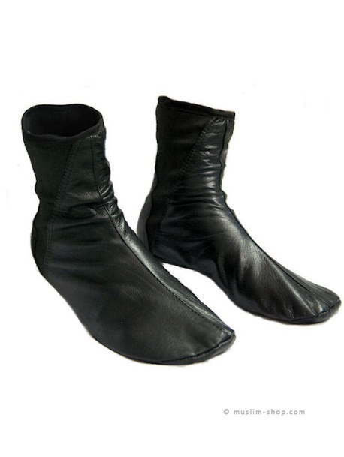
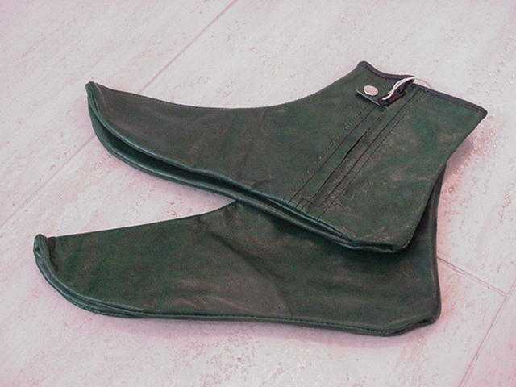
Leather Socks

